Slide 1
Dumbo
NuCli UFABC 2016
Lenin Cristi – Aerospace Engineering (a.k.a Rocket Science)

Slide 2


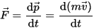


Slide 3


Slide 4
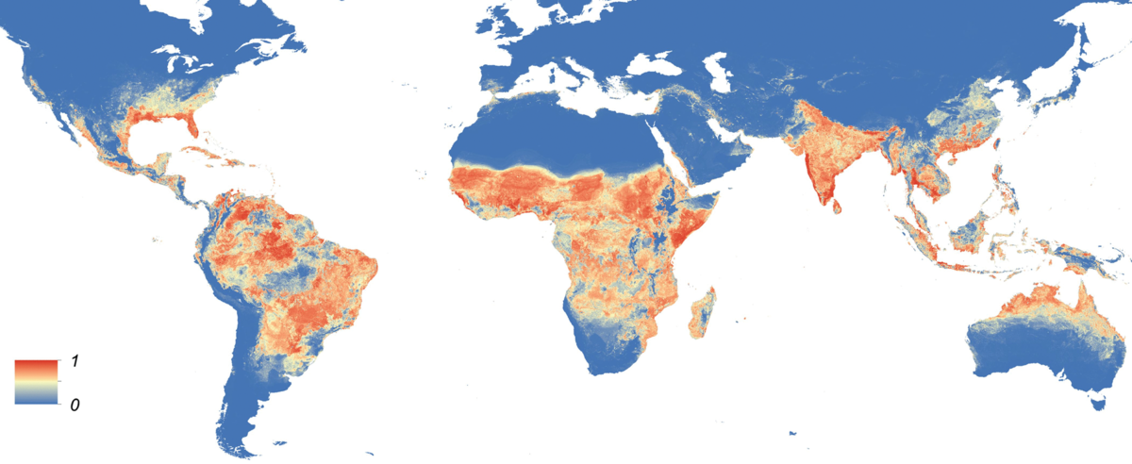
Aedes aegypti
(aēdēs from greek αηδής “hated“ ægypti from latin “from Egypt")
Global map of the predicted distribution of Aedes aegypti in 2015. The map depicts the probability of occurrence (from 0 blue to 1 red)
Very hard to control
Rapid adaptation in urban environments
Eggs resist months until the arrival of water
The water on a bottle cap is sufficient
Develops in dirty water
By Moritz UG Kraemer, Marianne E Sinka, Kirsten A Duda, Adrian QN Mylne, Freya M Shearer, Christopher M Barker, Chester G Moore, Roberta G Carvalho, Giovanini E Coelho, Wim Van Bortel, Guy Hendrickx, Francis Schaffner, Iqbal RF Elyazar, Hwa-Jen Teng, Oliver J Brady, Jane P Messina, David M Pigott, Thomas W Scott, David L Smith, GR William Wint, Nick Golding, Simon I Hay - elifesciences.org/content/4/e08347

Slide 5

Hadoop
It’s the “standard” BigData ecosystem
Created by Doug Cutting and Mike Cafarella in 2005
Inspired by Google papers on MapReduce and Google File System
Capable to compute massive parallel jobs across thousands of nodes
(from a toy of Doug's son)
Huge, immense, enormous, tremendous, large, big, whopping, gigantic, mammoth, gross, monumental, terrific, obscene amounts of data
https://en.wikipedia.org/wiki/Apache_Hadoop

Slide 6






Hadoop
2003/October Google File System paper released
2006/April Hadoop sorts 1.8TB on 188 nodes in 47.9h
2007/April Yahoo runs 2 clusters of 1,000 machines
2008/February Yahoo! production search index generated by a 10,000-core Hadoop cluster
2008/April (WR)Running on a 910-node cluster, Hadoop sorted one terabyte in 209s
2008/November Google MapReduce implementation sorted one terabyte in 68s
Only Facebook collects 15 terabytes of data per day. It’s equivalent to 1.5 of the entire US Congress library.
(from a toy of Doug's son)
2009/March Yahoo runs 17 clusters with 24,000 machines
2009/April Hadoop sorts a petabyte
2010/June Yahoo 4,000 nodes/70 petabytes
2010/June Facebook 2,300 clusters/40 petabytes
2011/January Facebook, LinkedIn, eBay and IBM collectively contribute 200,000 lines of code
https://en.wikipedia.org/wiki/Apache_Hadoop

Slide 7
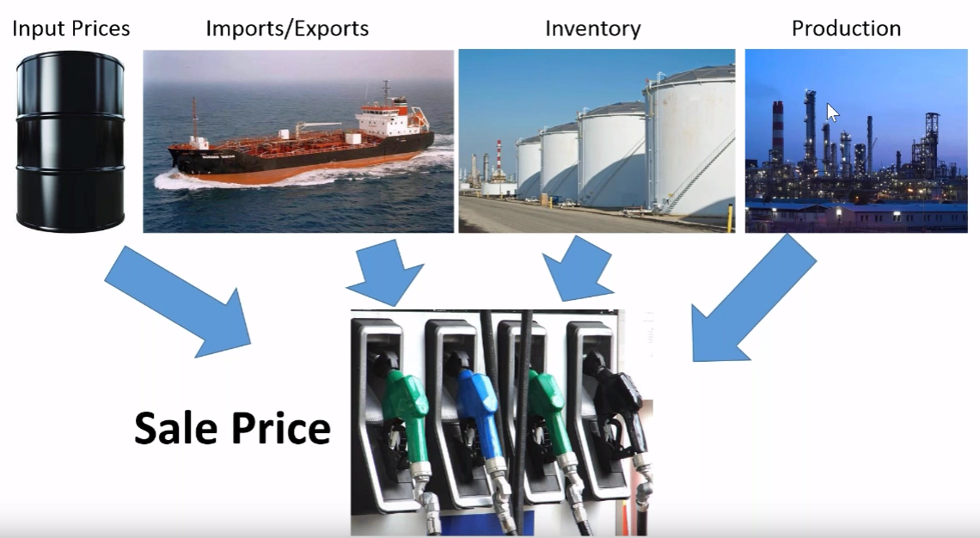
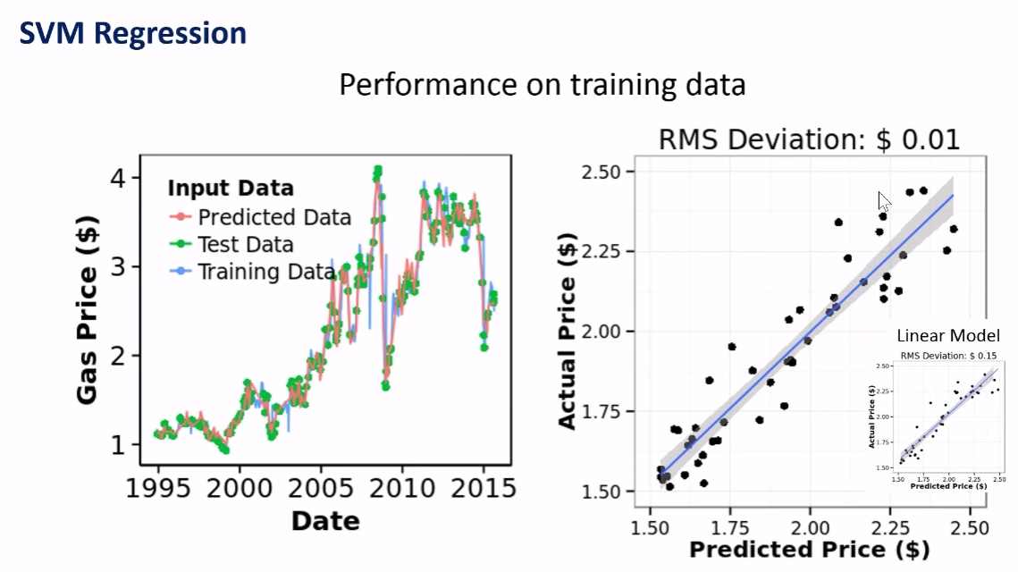
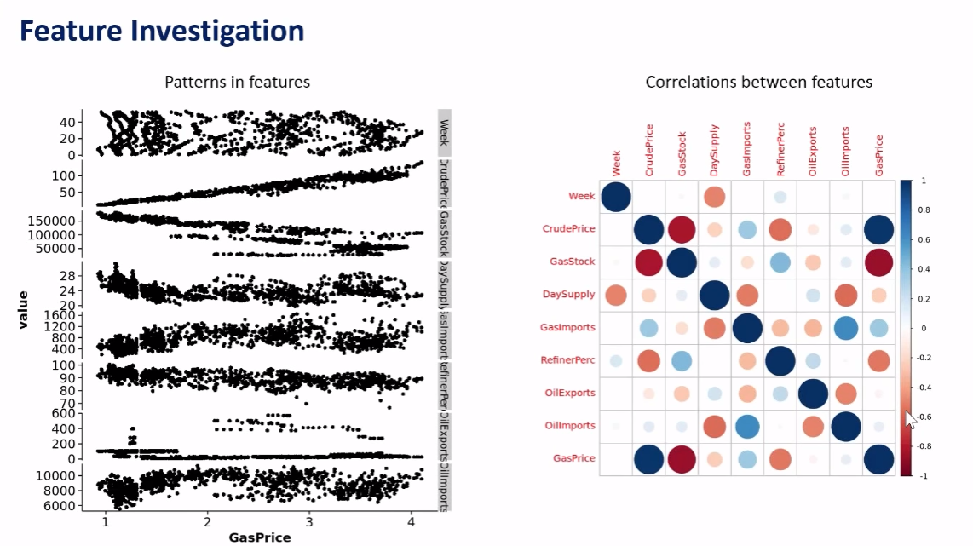


Martin John Madsen, Ph.D. - PASS Data Science Virtual Chapter - June 2016

Slide 8

And…
?

Slide 9
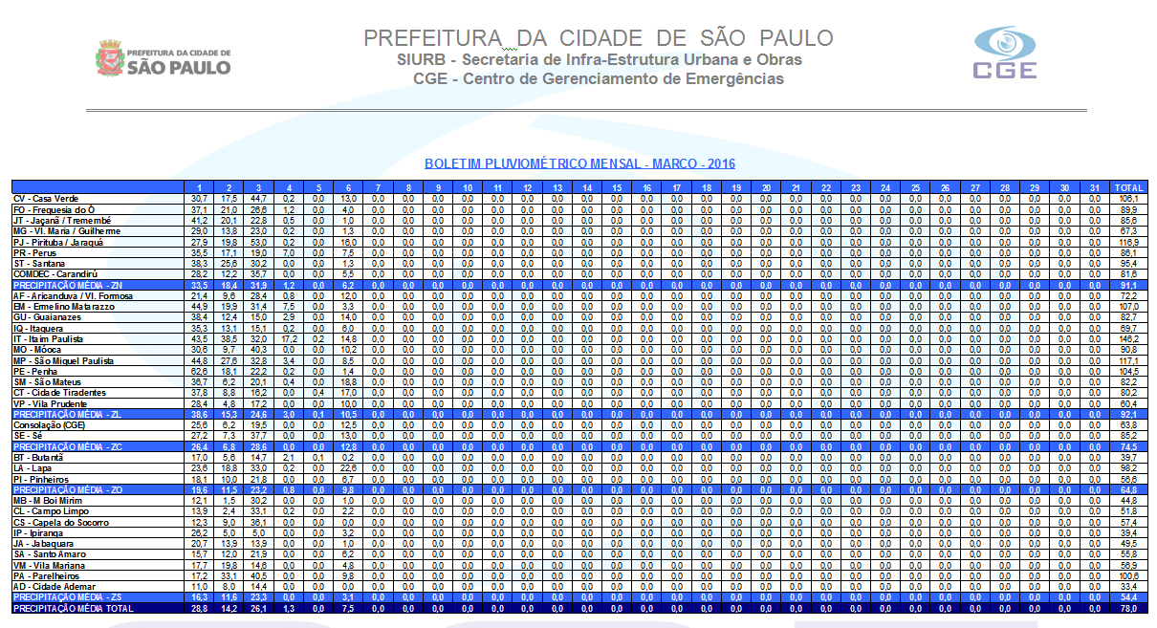

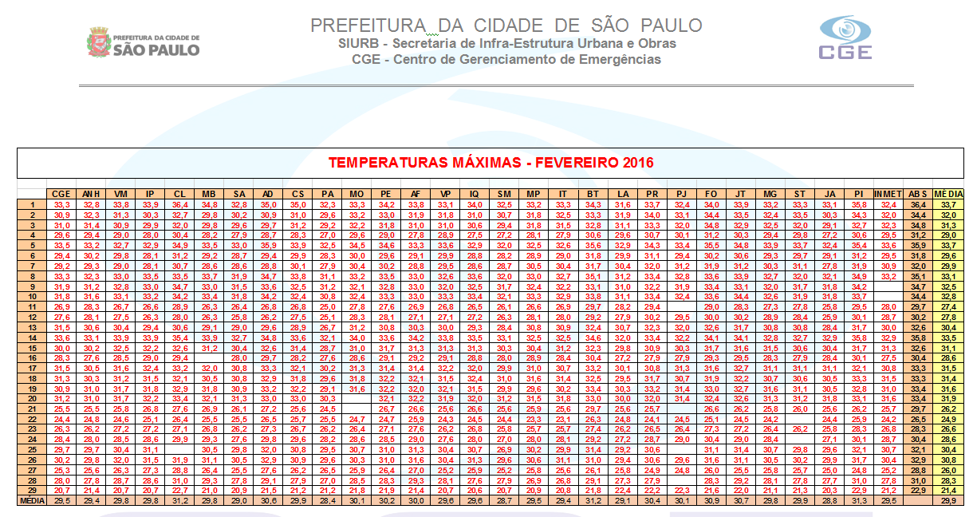
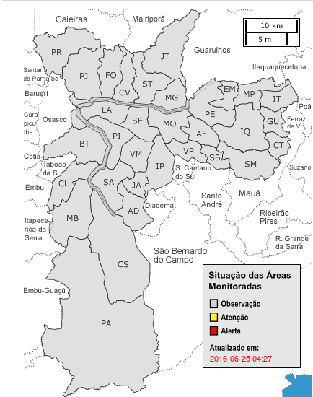
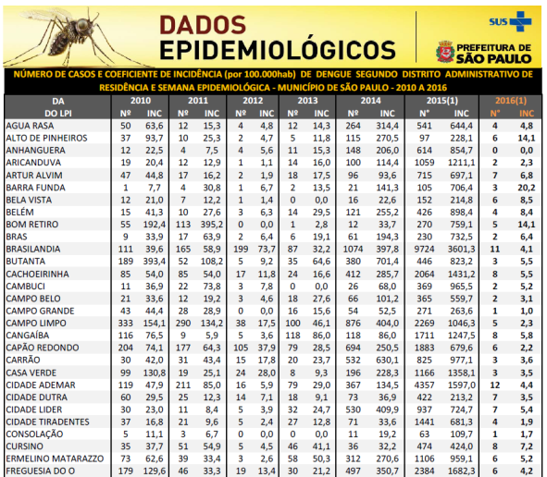
L.A.I.
CGE / PMSP - http://www.cgesp.org/v3/

Slide 10
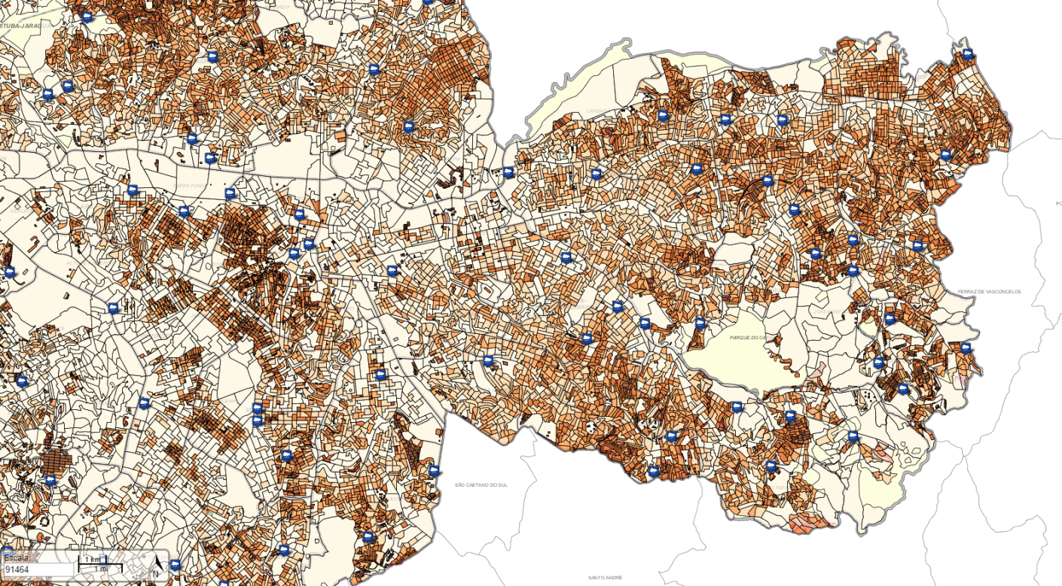
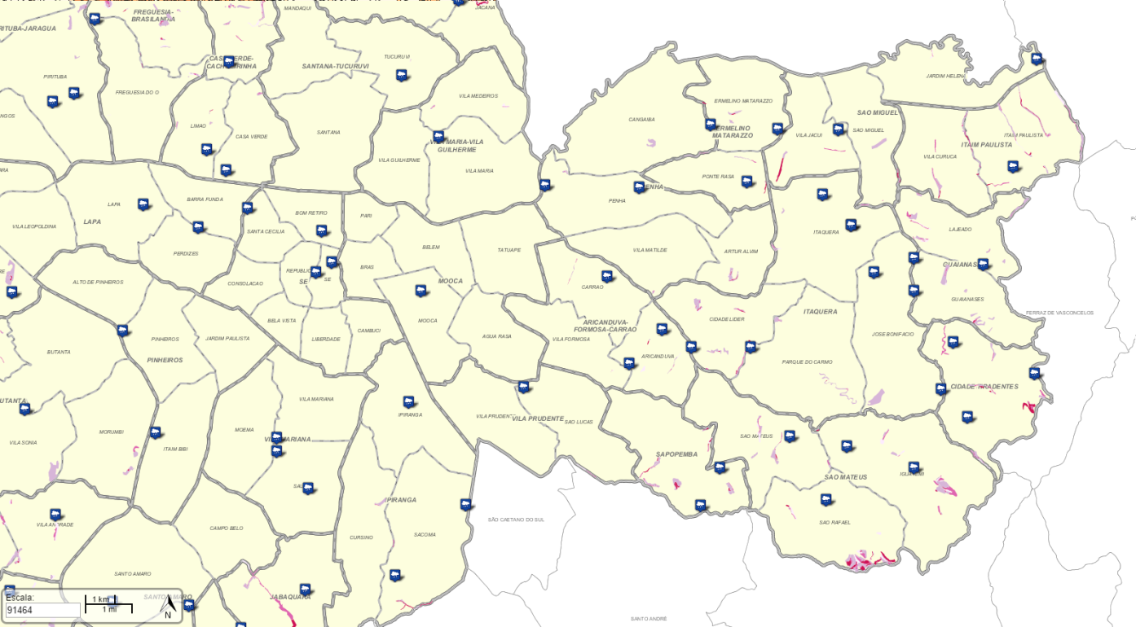
Based on the weather forecast plot focuses days in advance to the birth of mosquitoes
Increase the efficiency and effectiveness of combat strategies
Even predict the movement of the disease based on the reproductive cycle, rainfall and flying range
PMSP - http://geosampa.prefeitura.sp.gov.br

Slide 11






Ma'at

Slide 12
Ma'at

